Slide 1
UNIT-2 Objectives
Basic 2D Transformations :
1) Translation
2) Rotation
3) Scaling
Some more transformation
Shearing
Reflection

Slide 2
Geometric Transformations
Sometimes also called modeling transformations
Geometric transformations: Changing an object’s position (translation), orientation (rotation) or size (scaling)
Modeling transformations: Constructing a scene or hierarchical description of a complex object
Others transformations: reflection and shearing operations

Slide 3
Basic 2D Geometric Transformations
2D Translation
x’ = x + t_{x} , y’ = y + t_{y}
P’=P+T
Translation moves the object without deformation (rigid-body transformation)
P’
T
P

Slide 4
Basic 2D Geometric Transformations (cont.)
2D Translation
To move a line segment, apply the transformation equation to each of the two line endpoints and redraw the line between new endpoints
To move a polygon, apply the transformation equation to coordinates of each vertex and regenerate the polygon using the new set of vertex coordinates

Slide 5
2D Translation Routine
class wcPt2D {
public:
GLfloat x, y;
};
void translatePolygon (wcPt2D * verts, GLint nVerts, GLfloat tx, GLfloat ty)
{
GLint k;
for (k = 0; k < nVerts; k++) {
verts [k].x = verts [k].x + tx;
verts [k].y = verts [k].y + ty;
}
glBegin (GL_POLYGON);
for (k = 0; k < nVerts; k++)
glVertex2f (verts [k].x, verts [k].y);
glEnd ( );
}

Slide 6
Basic 2D Geometric Transformations (cont.)
2D Rotation
Rotation axis
Rotation angle
rotation point or pivot point (x_{r},y_{r})
y_{r}
θ
x_{r}

Slide 7
Basic 2D Geometric Transformations (cont.)
2D Rotation
If θ is positive → counterclockwise rotation
If θ is negative → clockwise rotation
Remember:
cos(a + b) = cos a cos b - sin a sin b
cos(a - b) = cos a sin b + sin a cos b

Slide 8
Basic 2D Geometric Transformations (cont.)
2D Rotation
At first, suppose the pivot point is at the origin
x’=r cos(θ+Φ) = r cos θ cos Φ - r sin θ sin Φ
y’=r sin(θ+Φ) = r cos θ sin Φ + r sin θ cos Φ
x = r cos Φ, y = r sin Φ
x’=x cos θ - y sin θ
y’=x sin θ + y cos θ
(x’,y’)
r
θ
r
(x,y)
Φ

Slide 9
Basic 2D Geometric Transformations
2D Rotation x’=x cos θ - y sin θ y’=x sin θ + y cos θ
P’=R·P
X
y
(x’,y’)
r
θ
r
(x,y)
Φ

Slide 10
Basic 2D Geometric Transformations (cont.)
2D Rotation
Rotation of a point about any specified position (x_{r},y_{r})
x’=x_{r}+(x - x_{r}) cos θ – (y - y_{r}) sin θ
y’=y_{r}+(x - x_{r}) sin θ + (y - y_{r}) cos θ
Rotations also move objects without deformation
A line is rotated by applying the rotation formula to each of the endpoints and redrawing the line between the new end points
A polygon is rotated by applying the rotation formula to each of the vertices and redrawing the polygon using new vertex coordinates

Slide 11
2D Rotation Routine
class wcPt2D {
public:
GLfloat x, y;
};
void rotatePolygon (wcPt2D * verts, GLint nVerts, wcPt2D pivPt, GLdouble theta)
{
wcPt2D * vertsRot;
GLint k;
for (k = 0; k < nVerts; k++) {
vertsRot [k].x = pivPt.x + (verts [k].x - pivPt.x) * cos (theta) - (verts [k].y - pivPt.y) * sin (theta);
vertsRot [k].y = pivPt.y + (verts [k].x - pivPt.x) * sin (theta) + (verts [k].y - pivPt.y) * cos (theta);
}
glBegin (GL_POLYGON);
for (k = 0; k < nVerts; k++)
glVertex2f (vertsRot [k].x, vertsRot [k].y);
glEnd ( );
}

Slide 12
Basic 2D Geometric Transformations (cont.)
2D Scaling
Scaling is used to alter the size of an object
Simple 2D scaling is performed by multiplying object positions (x, y) by scaling factors s_{x} and s_{y}
x’ = x · s_{x}
y’ = y · s_{y}
or P’ = S·P

Slide 13
Basic 2D Geometric Transformations (cont.)
2D Scaling
Any positive value can be used as scaling factor
Values less than 1 reduce the size of the object
Values greater than 1 enlarge the object
If scaling factor is 1 then the object stays unchanged
If s_{x} = s_{y} , we call it uniform scaling
If scaling factor <1, then the object moves closer to the origin and If scaling factor >1, then the object moves farther from the origin
x’
x

Slide 14
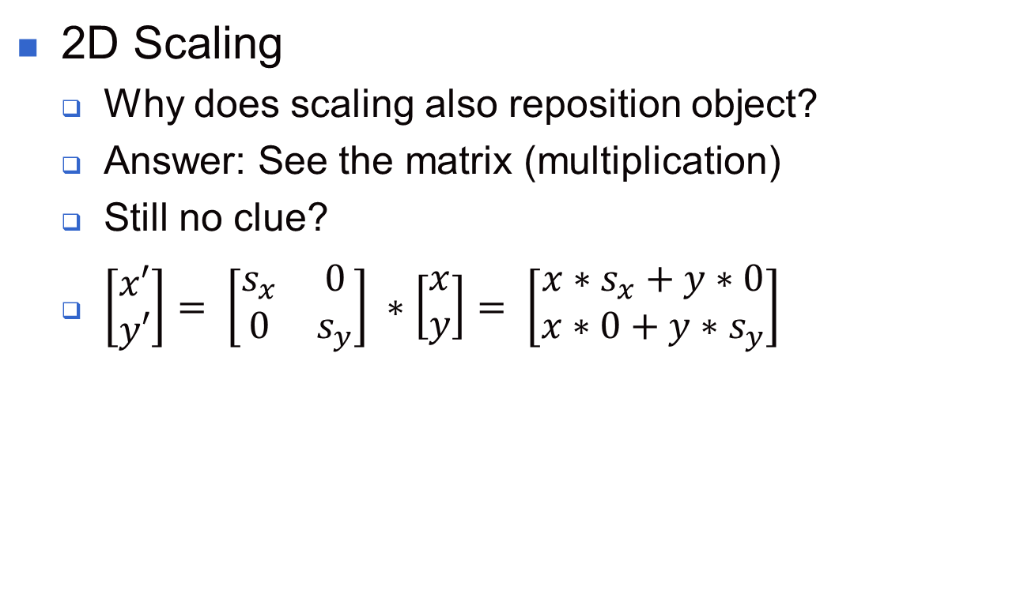
Basic 2D Geometric Transformations (cont.)
2D Scaling
Why does scaling also reposition object?
Answer: See the matrix (multiplication)
Still no clue?
$\left[\begin{matrix}x′ \\ y′\end{matrix}\right]= \left[\begin{matrix}s_{x} & 0 \\ 0 & s_{y}\end{matrix}\right] ∗\left[\begin{matrix}x \\ y\end{matrix}\right]= \left[\begin{matrix}x∗s_{x}+y∗0 \\ x∗0+y∗s_{y}\end{matrix}\right]$

Slide 15
Basic 2D Geometric Transformations (cont.)
2D Scaling
We can control the location of the scaled object by choosing a position called the fixed point (x_{f},y_{f})
x’ – x_{f} = (x – x_{f}) s_{x} y’ – y_{f} = (y – y_{f}) s_{y}
x’=x · s_{x} + x_{f} (1 – s_{x})
y’=y · s_{y} + y_{f} (1 – s_{y})
Polygons are scaled by applying the above formula to each vertex, then regenerating the polygon using the transformed vertices

Slide 16
2D Scaling Routine
class wcPt2D {
public:
GLfloat x, y;
};
void scalePolygon (wcPt2D * verts, GLint nVerts, wcPt2D fixedPt, GLfloat sx,
GLfloat sy)
{
wcPt2D vertsNew;
GLint k;
for (k = 0; k < n; k++) {
vertsNew [k].x = verts [k].x * sx + fixedPt.x * (1 - sx);
vertsNew [k].y = verts [k].y * sy + fixedPt.y * (1 - sy);
}
glBegin (GL_POLYGON);
for (k = 0; k < n; k++)
glVertex2v (vertsNew [k].x, vertsNew [k].y);
glEnd ( );
}

Slide 17
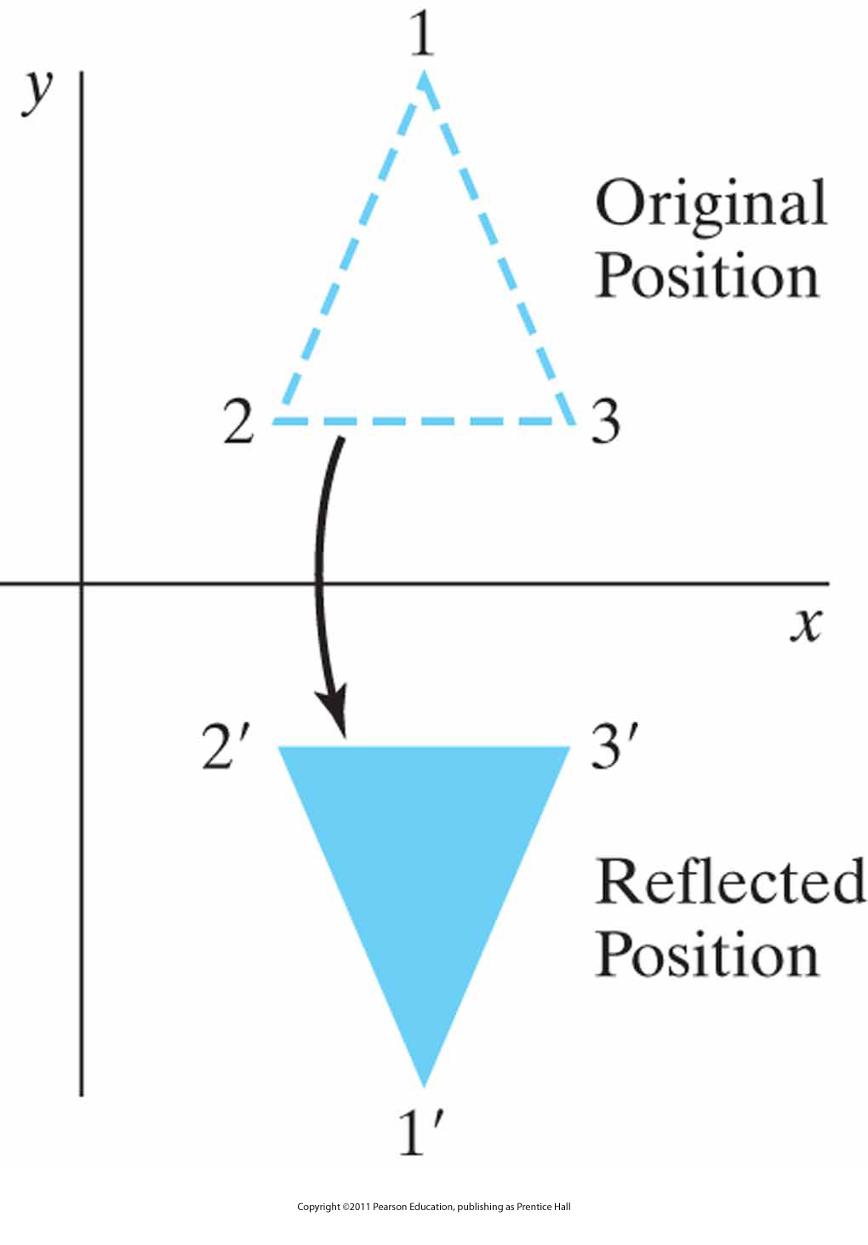
Other 2D Transformations
Reflection
Transformation that produces a mirror image of an object

Slide 18
Other 2D Transformations (cont.)
Reflection
Image is generated relative to an axis of reflection by rotating the object 180° about the reflection axis
Reflection about the line y=0 (the x axis) (previous slide)

Slide 19
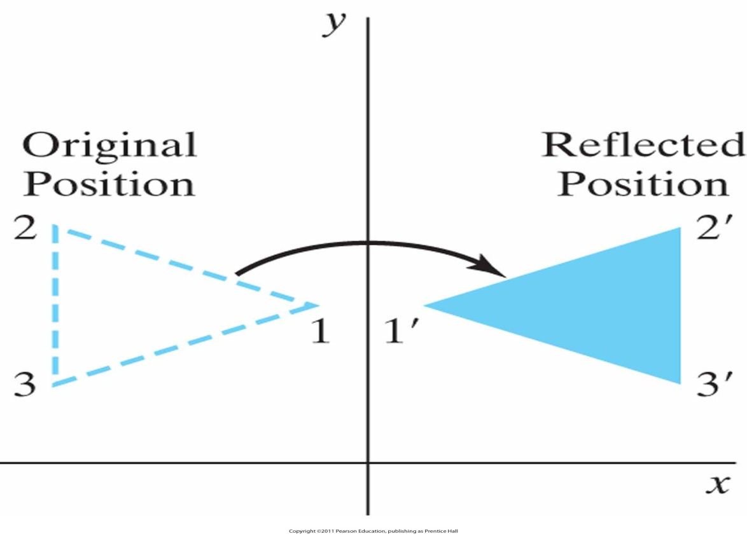
Other 2D Transformations (cont.)
Reflection
Reflection about the line x=0 (the y axis)

Slide 20
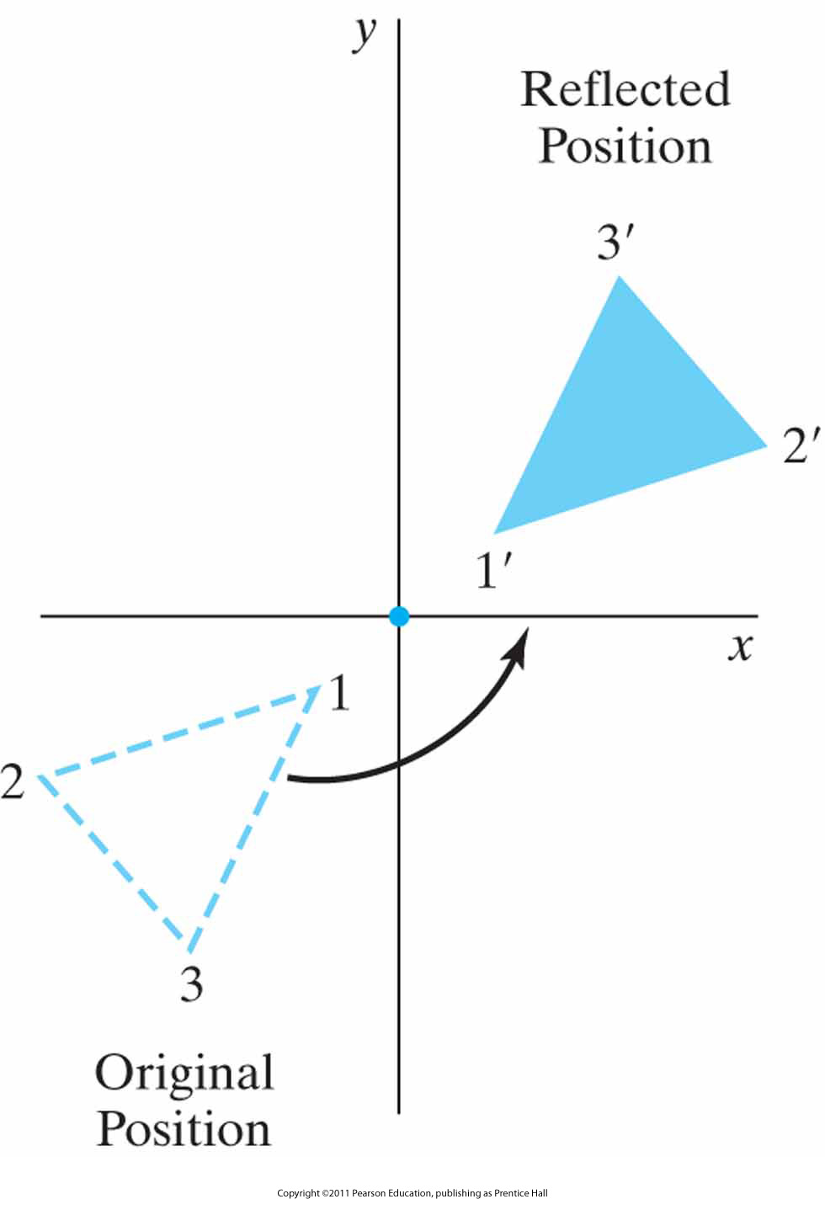
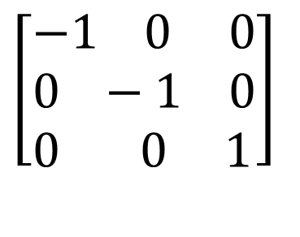
Other 2D Transformations (cont.)
Reflection about the origin
$$\left[\begin{aligned}&−1 0 0 \\ &0 −1 0 \\ &0 0 1\end{aligned}\right]$$

Slide 21
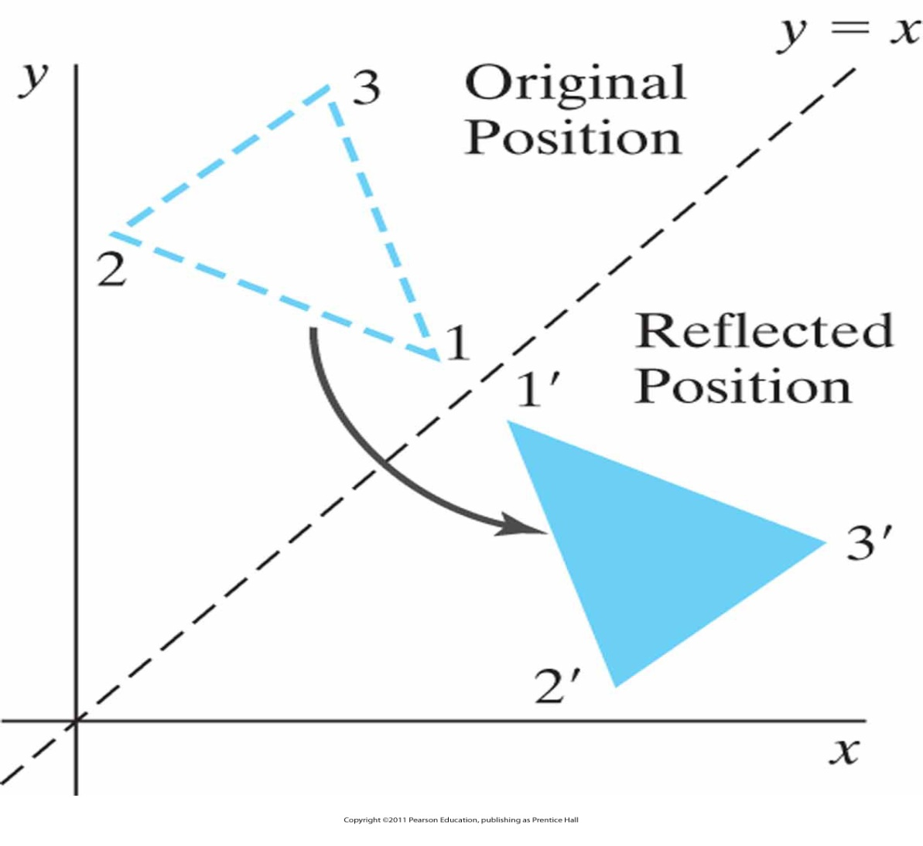
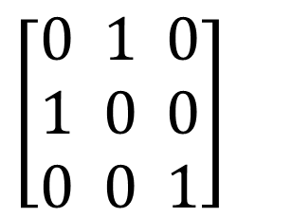
Other 2D Transformations (cont.)
Reflection about the line y=x
$$\left[\begin{aligned}&0 1 0 \\ &1 0 0 \\ &0 0 1\end{aligned}\right]$$

Slide 22
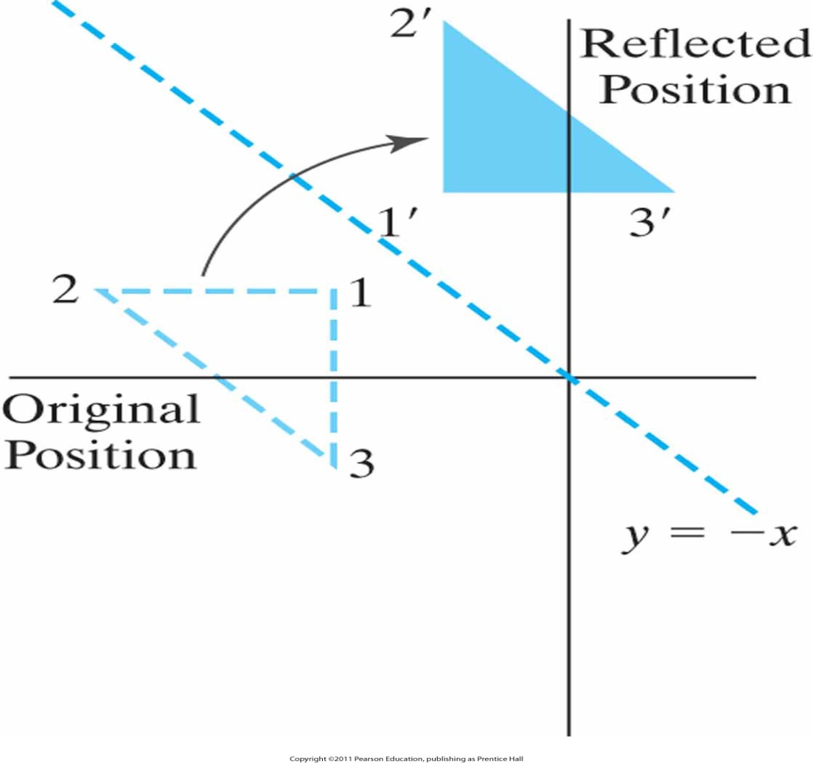
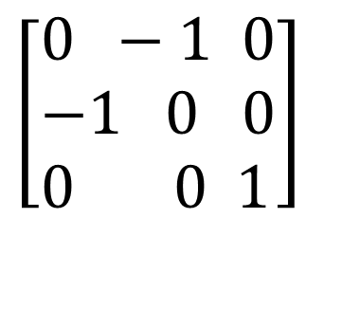
Other 2D Transformations (cont.)
Reflection about the line y=-x
$$\left[\begin{aligned}&0 −1 0 \\ &−1 0 0 \\ &0 0 1\end{aligned}\right]$$

Slide 23
Other 2D Transformations (cont.)
Shear
Transformation that distorts the shape of an object such that the transformed shape appears as the object was composed of internal layers that had been caused to slide over each other
y
y
(2,1)
(3,1)
(0,1)
(1,1)
(0,0)
(1,0)
(1,0)
x
(0,0)
x
sh_{x}=2

Slide 24
Other 2D Transformations (cont.)
Shear
x-direction shear relative to other reference lines

Slide 25
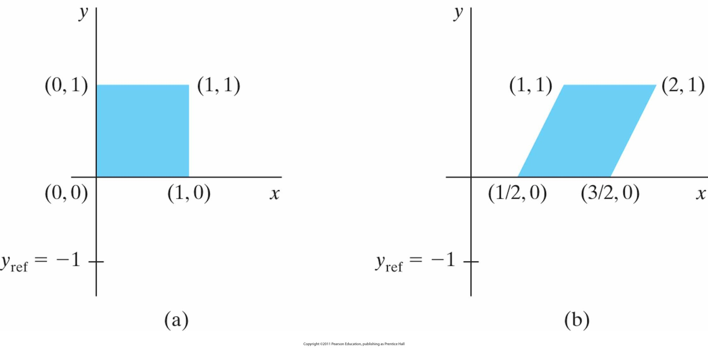
Example
A unit square (a) is transformed to a shifted parallelogram
(b) with sh_{x} = 0.5 and y_{ref} = −1 in the shear matrix from Slide 56

Slide 26
Other 2D Transformations (cont.)
Shear
y-direction shear relative to the line x = x_{ref}

Slide 27
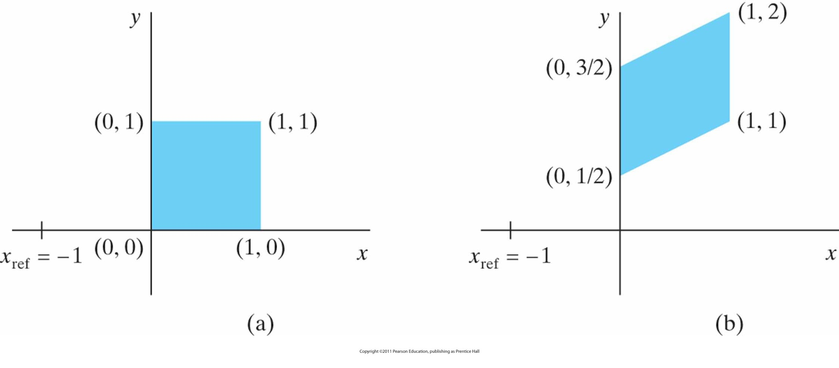
Example
A unit square (a) is turned into a shifted parallelogram
(b) with parameter values sh_{y} = 0.5 and x_{ref} = −1 in the y -direction shearing transformation from Slide 58

Slide 28
Matrix Representations and Homogeneous Coordinates
Many graphics applications involve sequences of geometric transformations
Animations
Design and picture construction applications
We will now consider matrix representations of these operations
Sequences of transformations can be efficiently processed using matrices

Slide 29
Matrix Representations and Homogeneous Coordinates (cont.)
P’ = M₁ · P + M₂
P and P’ are column vectors
M₁ is a 2 by 2 array containing multiplicative factors
M₂ is a 2 element column matrix containing translational terms
For translation M₁ is the identity matrix
For rotation or scaling, M₂ contains the translational terms associated with the pivot point or scaling fixed point

Slide 30
Matrix Representations and Homogeneous Coordinates (cont.)
To produce a sequence of operations, such as scaling followed by rotation then translation, we could calculate the transformed coordinates one step at a time
A more efficient approach is to combine transformations, without calculating intermediate coordinate values

Slide 31
Matrix Representations and Homogeneous Coordinates (cont.)
Multiplicative and translational terms for a 2D geometric transformation can be combined into a single matrix if we expand the representations to 3 by 3 matrices
We can use the third column for translation terms, and all transformation equations can be expressed as matrix multiplications

Slide 32
Matrix Representations and Homogeneous Coordinates (cont.)
Expand each 2D coordinate (x,y) to three element representation (x_{h},y_{h},h) called homogeneous coordinates
h is the homogeneous parameter such that x = x_{h}/h, y = y_{h}/h,
→ infinite homogeneous representations for a point
A convenient choice is to choose h = 1

Slide 33
Matrix Representations and Homogeneous Coordinates (cont.)
2D Translation Matrix
or, P’ = T(t_{x},t_{y})·P

Slide 34
Matrix Representations and Homogeneous Coordinates (cont.)
2D Rotation Matrix
or, P’ = R(θ)·P

Slide 35
Matrix Representations and Homogeneous Coordinates (cont.)
2D Scaling Matrix
or, P’ = S(s_{x},s_{y})·P

Slide 36
Inverse Transformations
2D Inverse Translation Matrix
By the way:

Slide 37
Inverse Transformations (cont.)
2D Inverse Rotation Matrix
And also:

Slide 38
Inverse Transformations (cont.)
2D Inverse Rotation Matrix:
If θ is negative → clockwise
In
Only sine function is affected
Therefore we can say
Is that true?
Proof: It’s up to you ☺

Slide 39
Inverse Transformations (cont.)
2D Inverse Scaling Matrix
Of course:

Slide 40
2D Composite Transformations
We can setup a sequence of transformations as a composite transformation matrix by calculating the product of the individual transformations
P’=M₂·M₁·P
=M·P

Slide 41
2D Composite Transformations (cont.)
Composite 2D Translations
If two successive translation are applied to a point P, then the final transformed location P' is calculated as

Slide 42
2D Composite Transformations (cont.)
Composite 2D Rotations

Slide 43
2D Composite Transformations (cont.)
Composite 2D Scaling

Slide 44
2D Composite Transformations (cont.)
Don’t forget:
Successive translations are additive
Successive scalings are multiplicative
For example: If we triple the size of an object twice, the final size is nine (9) times the original
9 times?
Why?
Proof: Again up to you ☺

Slide 45
General Pivot Point Rotation
Steps:
Translate the object so that the pivot point is moved to the coordinate origin.
Rotate the object about the origin.
Translate the object so that the pivot point is returned to its original position.

Slide 46
General Pivot Point Rotation

Slide 47
2D Composite Transformations (cont.)
General 2D Pivot-Point Rotation

Slide 48
General Fixed Point Scaling
Steps:
Translate the object so that the fixed point coincides with the coordinate origin.
Scale the object about the origin.
Translate the object so that the pivot point is returned to its original position.

Slide 49
General Fixed Point Scaling (cont.)
(x_{r,} y_{r})
(x_{r,} y_{r})

Slide 50
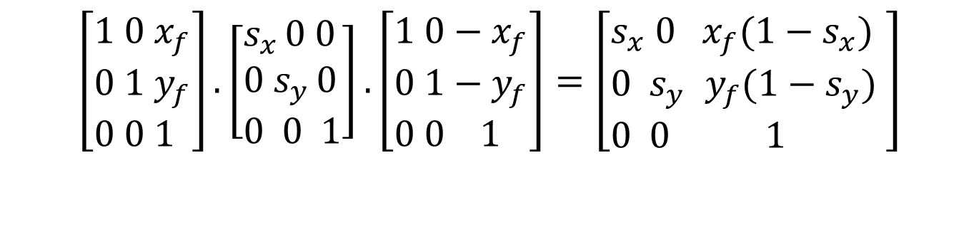
General Fixed Point Scaling (cont.)
General 2D Fixed-Point Scaling:
$$\left[\begin{aligned}&1 0{ x}_{f} \\ &0 1 y_{f} \\ &0 0 1\end{aligned}\right].\left[\begin{aligned}&s_{x }0 0 \\ &0{ s}_{y }0 \\ &0 0 1\end{aligned}\right].\left[\begin{aligned}&1 0−x_{f} \\ &0 1−y_{f} \\ &0 0 1\end{aligned}\right]=\left[\begin{aligned}&s_{x} 0{ x}_{f}(1−s_{x}) \\ &0{ s}_{y }y_{f}(1−s_{y}) \\ &0 0 1\end{aligned}\right]$$
$$T(x_{f},y_{f})⋅S(s_{x},s_{y})⋅T(−x_{f},−y_{f})=S(x_{f},y_{f},s_{x},s_{y})$$

Slide 51
2D Composite Transformations (cont.)
General 2D scaling directions:
Above: scaling parameters were along x and y directions
What about arbitrary directions?
Answer: See next slides

Slide 52
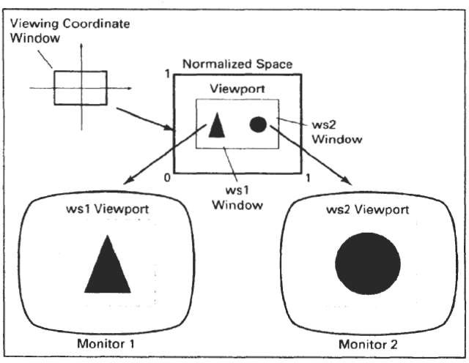
Windowing and Clipping:
It consider the formal mechanism for displaying views of a picture on an output device.
For a two-dimensional picture, a view is selected by specifying a subarea of the total picture area.

Slide 53
Windowing and Clipping:
A user can select a single area for display, or several areas could be selected for simultaneous display.
Transformations from world to device coordinates involve translation, rotation, and scaling operations, as well as procedures for deleting those parts of the picture that are outside the limits of a selected display area.(clipping)

Slide 54
Windowing and Clipping:
Transformations from world to device coordinates involve translation, rotation, and scaling operations, as well as procedures for deleting those parts of the picture that are outside the limits of a selected display area.(clipping)

Slide 55
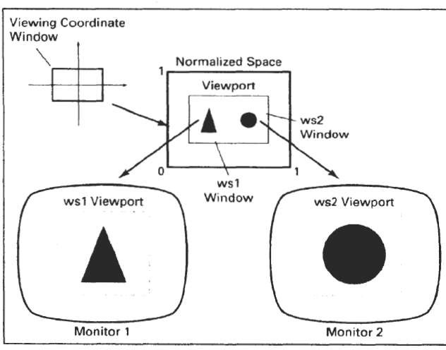
Viewing Pipeline
Window
A world-coordinate area selected for display is called a window.
Viewport
An area on a display device to which a window is mapped is called a viewport.
The window defines what is to be viewed; the viewport defines where it is to be displayed.

Slide 56
Viewing Pipeline
Viewing Transformation.
The mapping of a part of a world- coordinate scene to device coordinates is referred to as a viewing transformation.

Slide 57
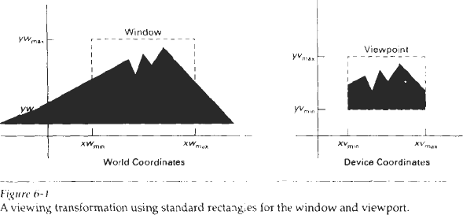
Viewing Pipeline
Figure 6-1 illustrates the mapping of a picture section that falls within a rectangular window onto a designated & angular viewport.

Slide 58
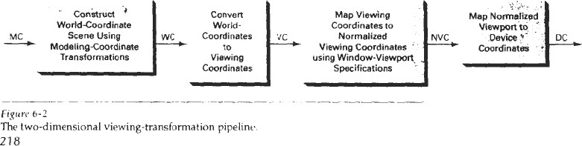
Viewing Pipeline
It consist a sequence of steps used to perform two dimensional
viewing transformations
The major steps are as follows

Slide 59
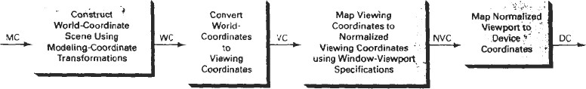
Viewing Pipeline
We construct the scene in world coordinates
We then transform descriptions in world coordinates to viewing coordinates.
We then define viewport in normalized coordinates (in the range from 0 to 1)
At the final step, all parts of the picture that he outside the viewport are clipped, and the contents of the viewport are transformed to device coordinates.

Slide 60
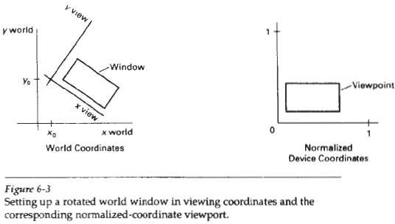
Viewing Pipeline

Slide 61
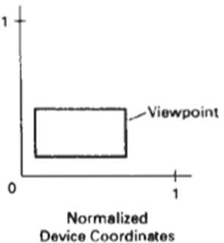
Normalized Coordinates
Viewports are typically defined within the unit square (normalized coordinates).
This provides a means for separating the viewing and other transformations from specific output- device requirements, so that the graphics package is largely device-independent.

Slide 62
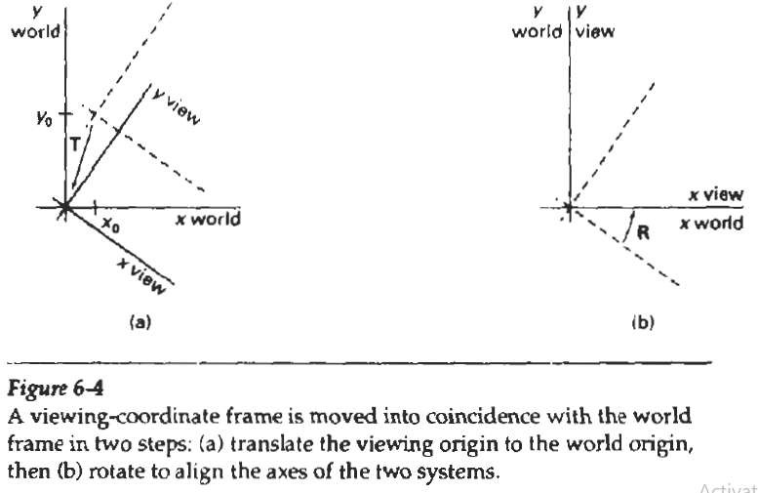
Viewing Coordinate Reference Frame
translate the viewing origin to the world origin,
rotate to align the axes of the two systems.

Slide 63

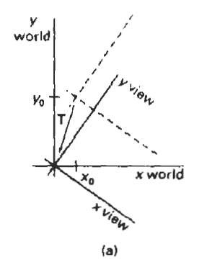
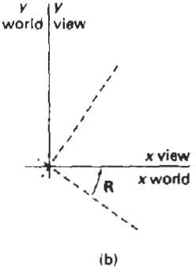
Viewing Coordinate Reference Frame
The composite two-dimensional transformation to convert world coordinates to viewing coordinate is
where T is the translation matrix that takes the viewing origin point P to the world origin, and R is the rotation matrix that aligns the axes of the two reference frames.

Slide 64
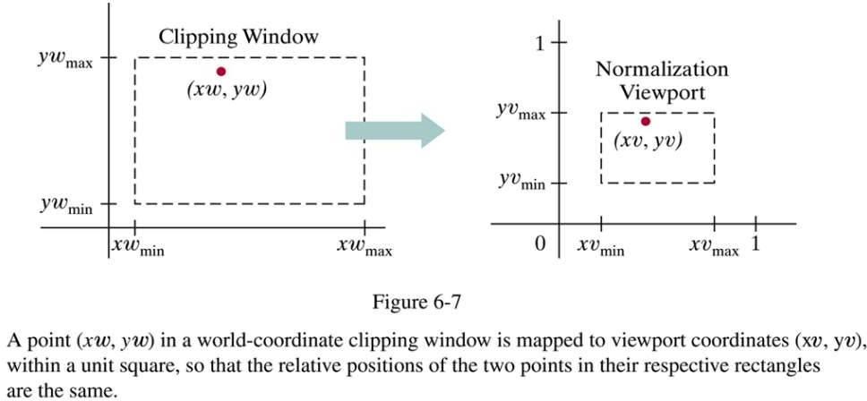
6.3 WINDOW-TO-VIEWPORT COORDINATE TRANSFORMATION

Slide 65
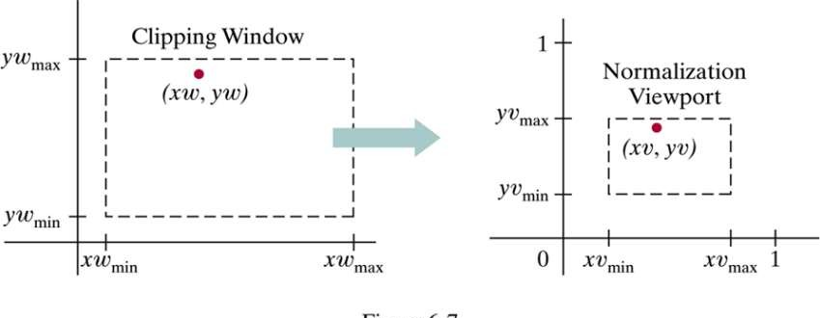
We maintain the same relative placement in the viewport as in the window.
If a coordinate position is at the center of the world window, for instance, it will be displayed at the center of the viewport.

Slide 66
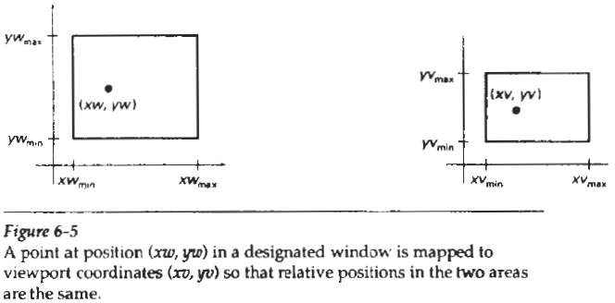
A point at position (xw,yx) in the window is mapped into position
(xv,yv) in the associated viewport.

Slide 67
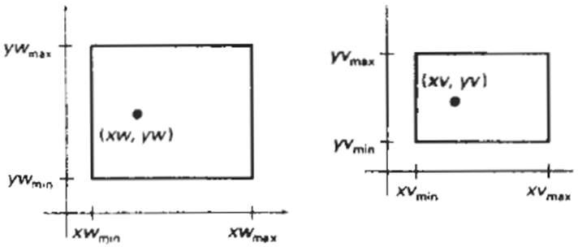
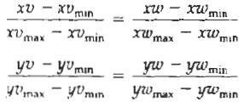
We maintain the same relative placement in the viewport as in the window.

Slide 68
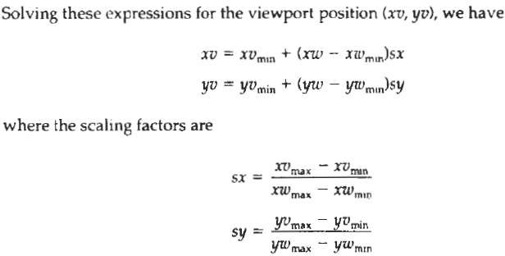
6.3 WINDOW-TO-VIEWPORT COORDINATE TRANSFORMATION

Slide 69
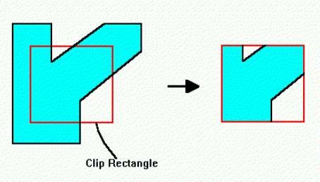
2-D Clipping Algorithms

Slide 70
2-D Clipping Algorithms
Clipping - Any procedure that identifies those portions of a picture
that are either inside or outside of a specified region of space is called a clip
referred to as a clipping algorithm, or simply clipping.
The region against which an object is to clipped is window.

Slide 71
Applications Of Clipplng
Applications of clipping include
Drawing and painting operations that allow parts of a picture to be selected for copying, moving, erasing, or duplicating.
Extracting part of a defined scene for viewing;
Identifying visible surfaces in three-dimensional vlews;
Antialiasing line segments or object boundaries;
Creating objects using solid-modeling procedures;
Displaying a multi window environment;

Slide 72
Types of clipping
We consider algorithms for clipping the following primitive types
Point Clipping
Line Clipping (straight-line segments)
Area Clipping (polygons)
Curve Clipping
Text Clipping

Slide 73
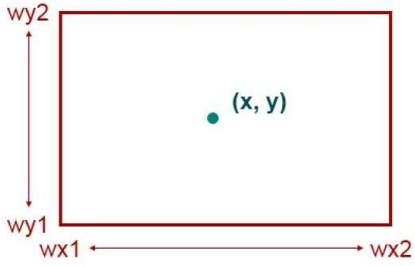
Point Clipping
we save a point P = (x, y) if it is inside the clipping window.

Slide 74

Point Clipping
Assuming that the clip window is a rectangle in standard position, we save a point P = (x, y) for display if the following inequalities are satisfied:
where the edges of the clip window can be either the world-coordinate window boundaries or viewport boundaries. If any one of these four inequalities is not satisfied, the point is clipped (not saved for display).

Slide 75
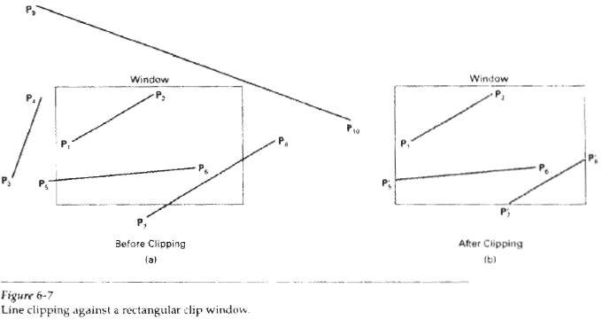
Line Clipping Algorithms

Slide 76
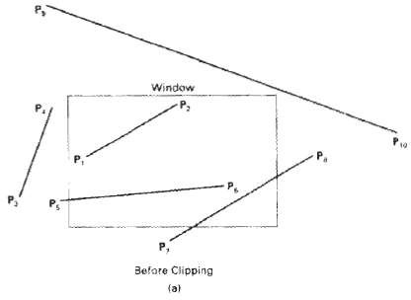
Line Clipping Algorithms
A line clipping procedure involves several parts.
First, we can test a given line segment to determine whether it lies completely inside the clipping window.
If it does not, we try to determine whether it lies completely outside the window.
Finally, we must perform intersection calculations with one or more clipping boundaries.

Slide 77
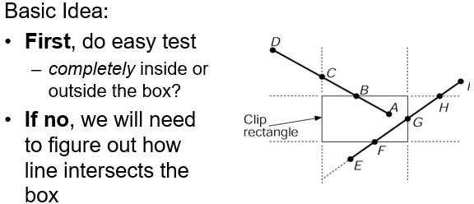
Cohen Sutherland Line Clipping Algorithm

Slide 78
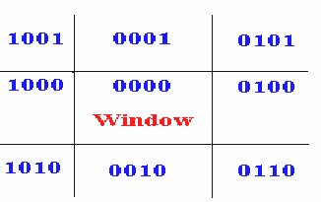
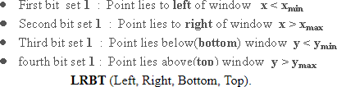
Cohen Sutherland Line Clipping Algorithm
Every line end point in a picture is assigned a four-digit binary code, called a region code, that identifies the location of the point relative to the boundaries of the clipping rectangle.

Slide 79
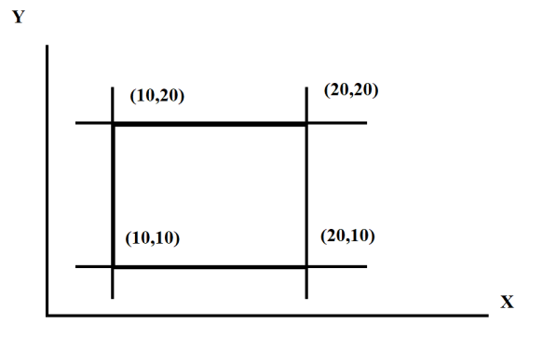
Cohen Sutherland Line Clipping Algorithm
Find color codes of the points
P1(5,6) P2 (25,15) P2 (25,15)
P4(15,60) P5 (15,15) P6 (25,40)

Slide 80
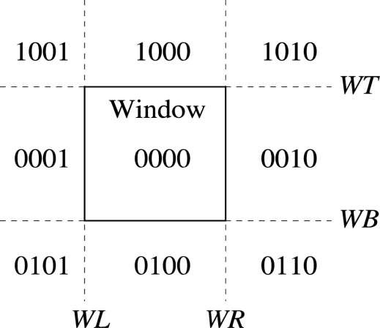

Cohen Sutherland
0101
1010
32

Slide 81
Cohen Sutherland
0101
0010
33

Slide 82
Cohen Sutherland
0001
0010
34

Slide 83
Cohen Sutherland
0001
0000
35

Slide 84
Cohen Sutherland
0000
0000
36

Slide 85
Cohen Sutherland Line Clipping Algorithm
Trivial Acceptance
If the logical OR is zero, the line can be trivially accepted.
For example, if the endpoint codes are 0000 and 0000, the logical OR is 0000 - the line can be trivially accepted.
If the endpoint codes are 0000 and 0110, the logical OR is 0110 and the line can not be trivally accepted.

Slide 86
Cohen Sutherland Line Clipping Algorithm
Trivial Rejection
If the logical AND of the endpoint codes is not zero, the line can be trivally rejected.
For example, if an endpoint had a code of 1001 while the other endpoint had a code of 1010, the logical AND would be 1000 which indicates the line segment lies outside of the window.
On the other hand, if the endpoints had codes of 1001 and 0110, the logical AND would be 0000, and the line could not be trivally rejected.

Slide 87
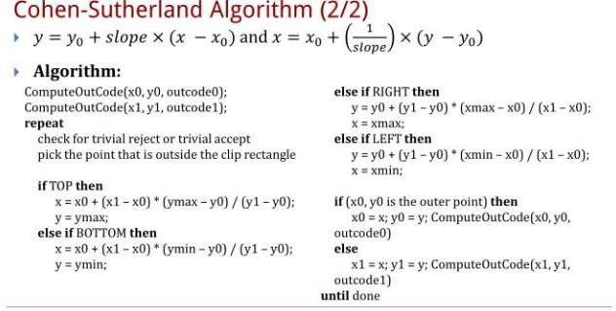

Slide 88
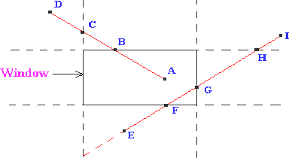
Cohen Sutherland Line Clipping Example
Consider the line segment AD.
Point A has an outcode of 0000 and point D has an outcode of 1001.
The logical AND of these outcodes is zero;
therefore, the line cannot be trivally rejected.
Also, the logical OR of the outcodes is not zero; therefore, the line cannot be trivally accepted.
The algorithm then chooses D as the outside point (its outcode contains 1's).
By our testing order, we first use the top edge to clip AD at B. The algorithm then recomputes B's outcode as 0000.
With the next iteration of the algorithm, AB is tested and is trivially accepted and displayed.

Slide 89
Cohen Sutherland Line Clipping Example
Consider the line segment EI.
Point E has an outcode of 0100, while point I's outcode is 1010.
The results of the trivial tests show that the line can neither be trivally rejected or accepted.
Point E is determined to be an outside point, so the algorithm clips the line against the bottom edge of the window.
Now line EI has been clipped to be line FI.
Line FI is tested and cannot be trivially accepted or rejected. Point F has an outcode of 0000, so the algorithm chooses point I as an outside point since its outcode is1010.

Slide 90
Cohen Sutherland Line Clipping Example
Line FI is tested and cannot be trivially accepted or rejected.
Point F has an outcode of 0000, so the algorithm chooses point I as an outside point since its outcode is1010.
The line FI is clipped against the window's top edge, yielding a new line FH.
Line FH cannot be trivally accepted or rejected. Since H's outcode is 0010, the next iteration of the algorthm clips against the window's right edge, yielding line FG.
The next iteration of the algorithm tests FG, and it is trivially accepted and display.

Slide 91
Cohen Sutherland Line Clipping Algorithm
Numerical
Find visible portion of the line between points
P1(x0,y0) = (12,8)
P2(x1,y1) = (15,15)

Slide 92
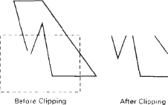
Polygon Clipping
For polygon clipping, we require an algorithm that wiIl generate one or more closed areas that are then scan converted for the appropriate area fill.
What we reaIly want to display is a bounded area after clipping.

Slide 93
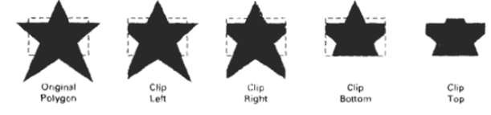
Sutherland Hodgeman Polygon Clipping
Beginning with the initial set of polygon vertices, we could first clip the polygon against the left rectangle boundary to produce a new sequence of vertices.
The new set of vertices could then k successively passed to a right boundary clipper, a bottom boundary clipper, and a top boundary clipper.

Slide 94
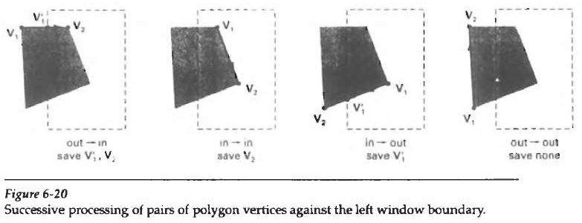
Four Cases Out-In, In-In, In-out, Out-out

Slide 95
Sutherland Hodgeman Polygon Clipping
As each pair of adjacent polygon vertices is passed to a window boundary clipper, we make the following tests:
Out-In - If the first vertex is outside the window boundary and the second vertex is inside, both the intersection point of the polygon edge with the window boundary and the second vertex are added to the output vertex list.
In-In If both input vertices are inside the window boundary, only the second vertex is added to the output vertex list.
In-Out- If the first vertex is inside the window boundary and second vertex is outside the boundary, only the edge intersection with the window boundary is added to the output vertex list.
Out-Out- If both input vertices are outside the window boundary, nothing is added to the output list.

Slide 96
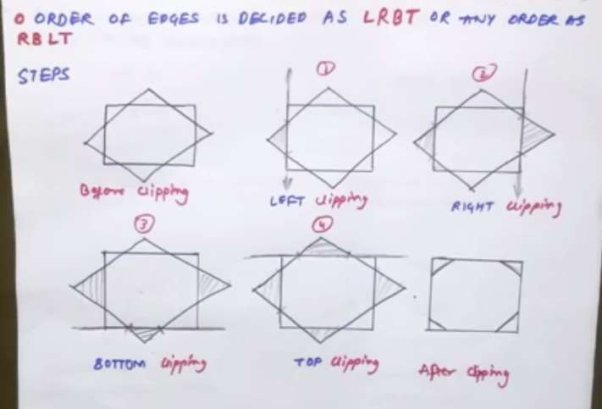

Slide 97
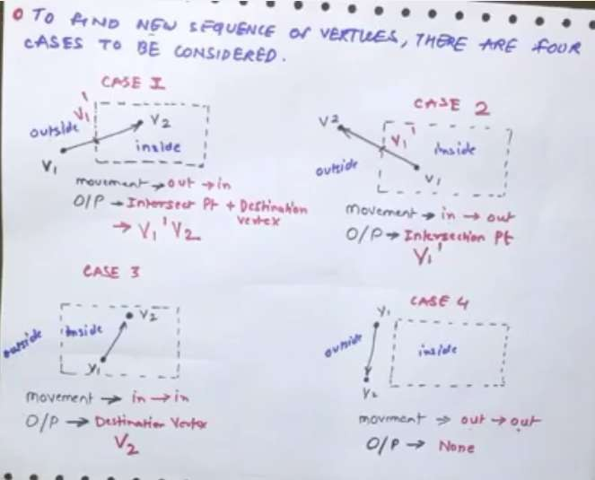

Slide 98
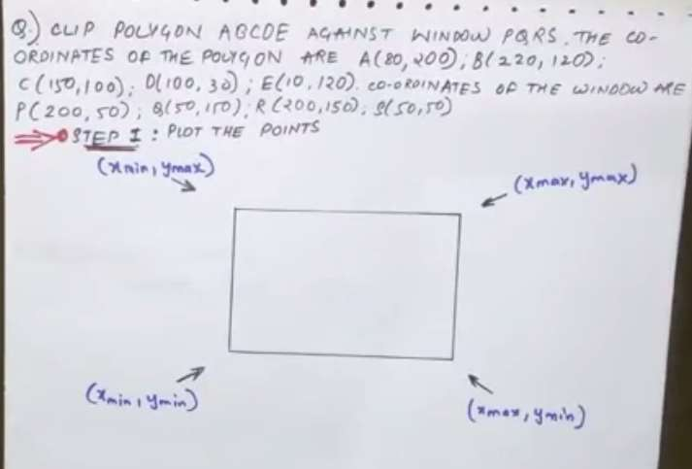

Slide 99
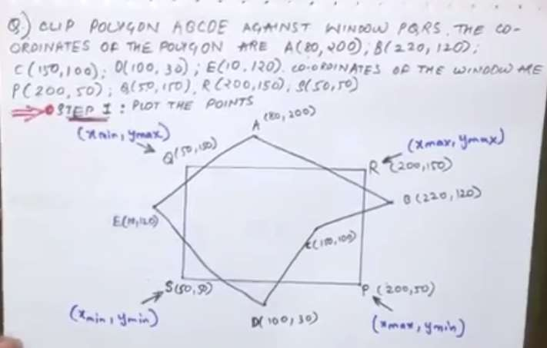

Slide 100
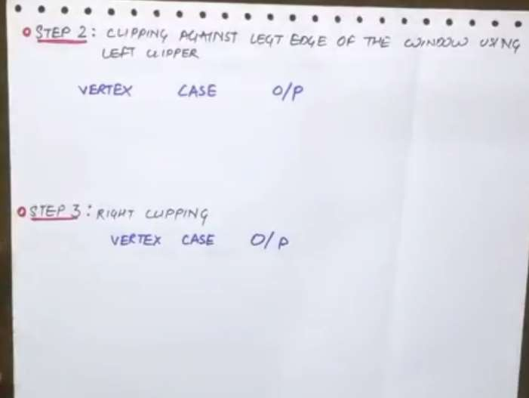

Slide 101
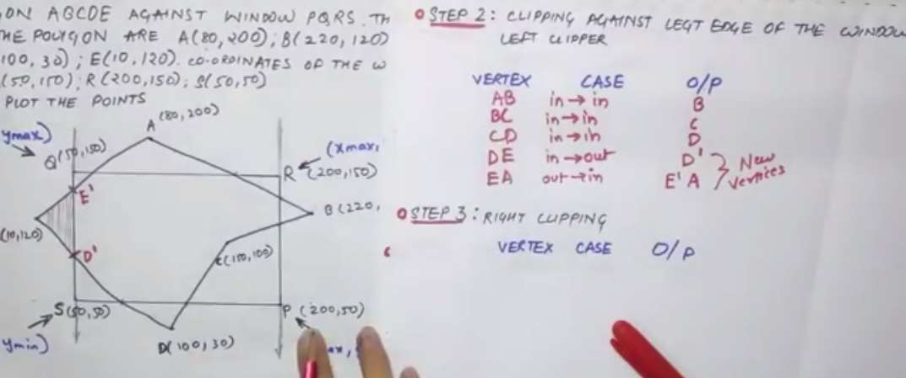

Slide 102
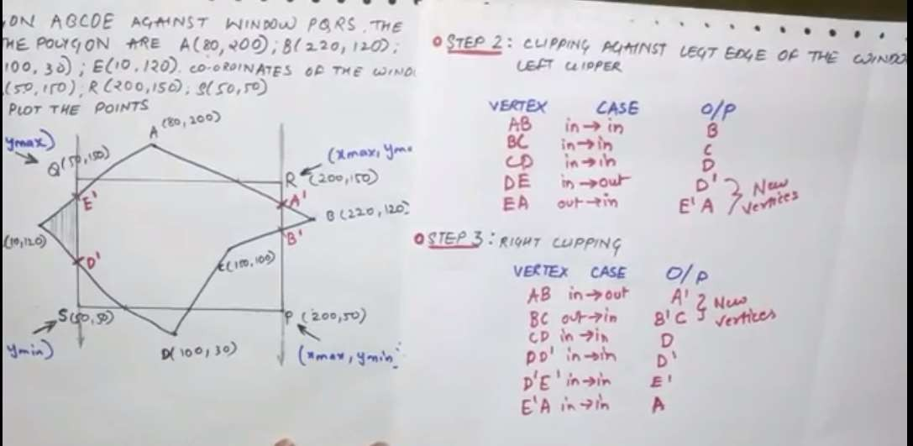

Slide 103
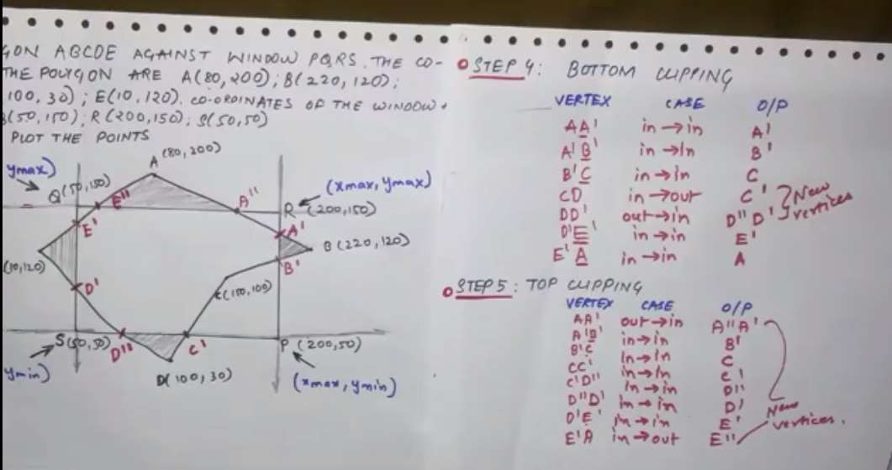

Slide 104


